Slide 1


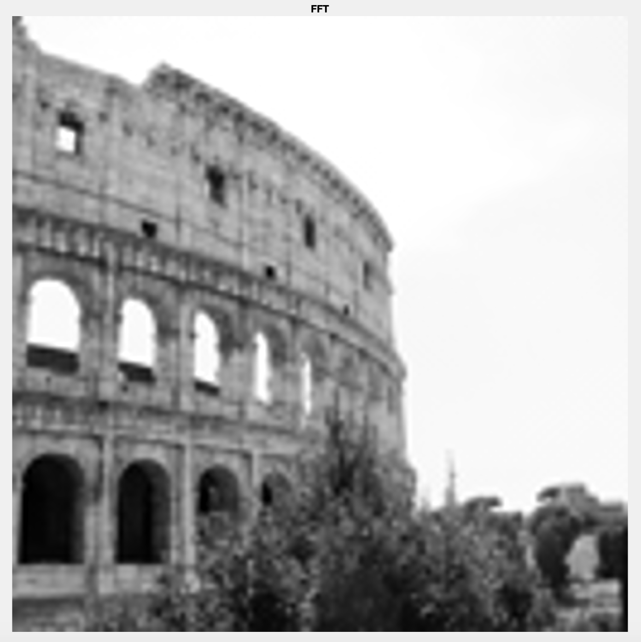
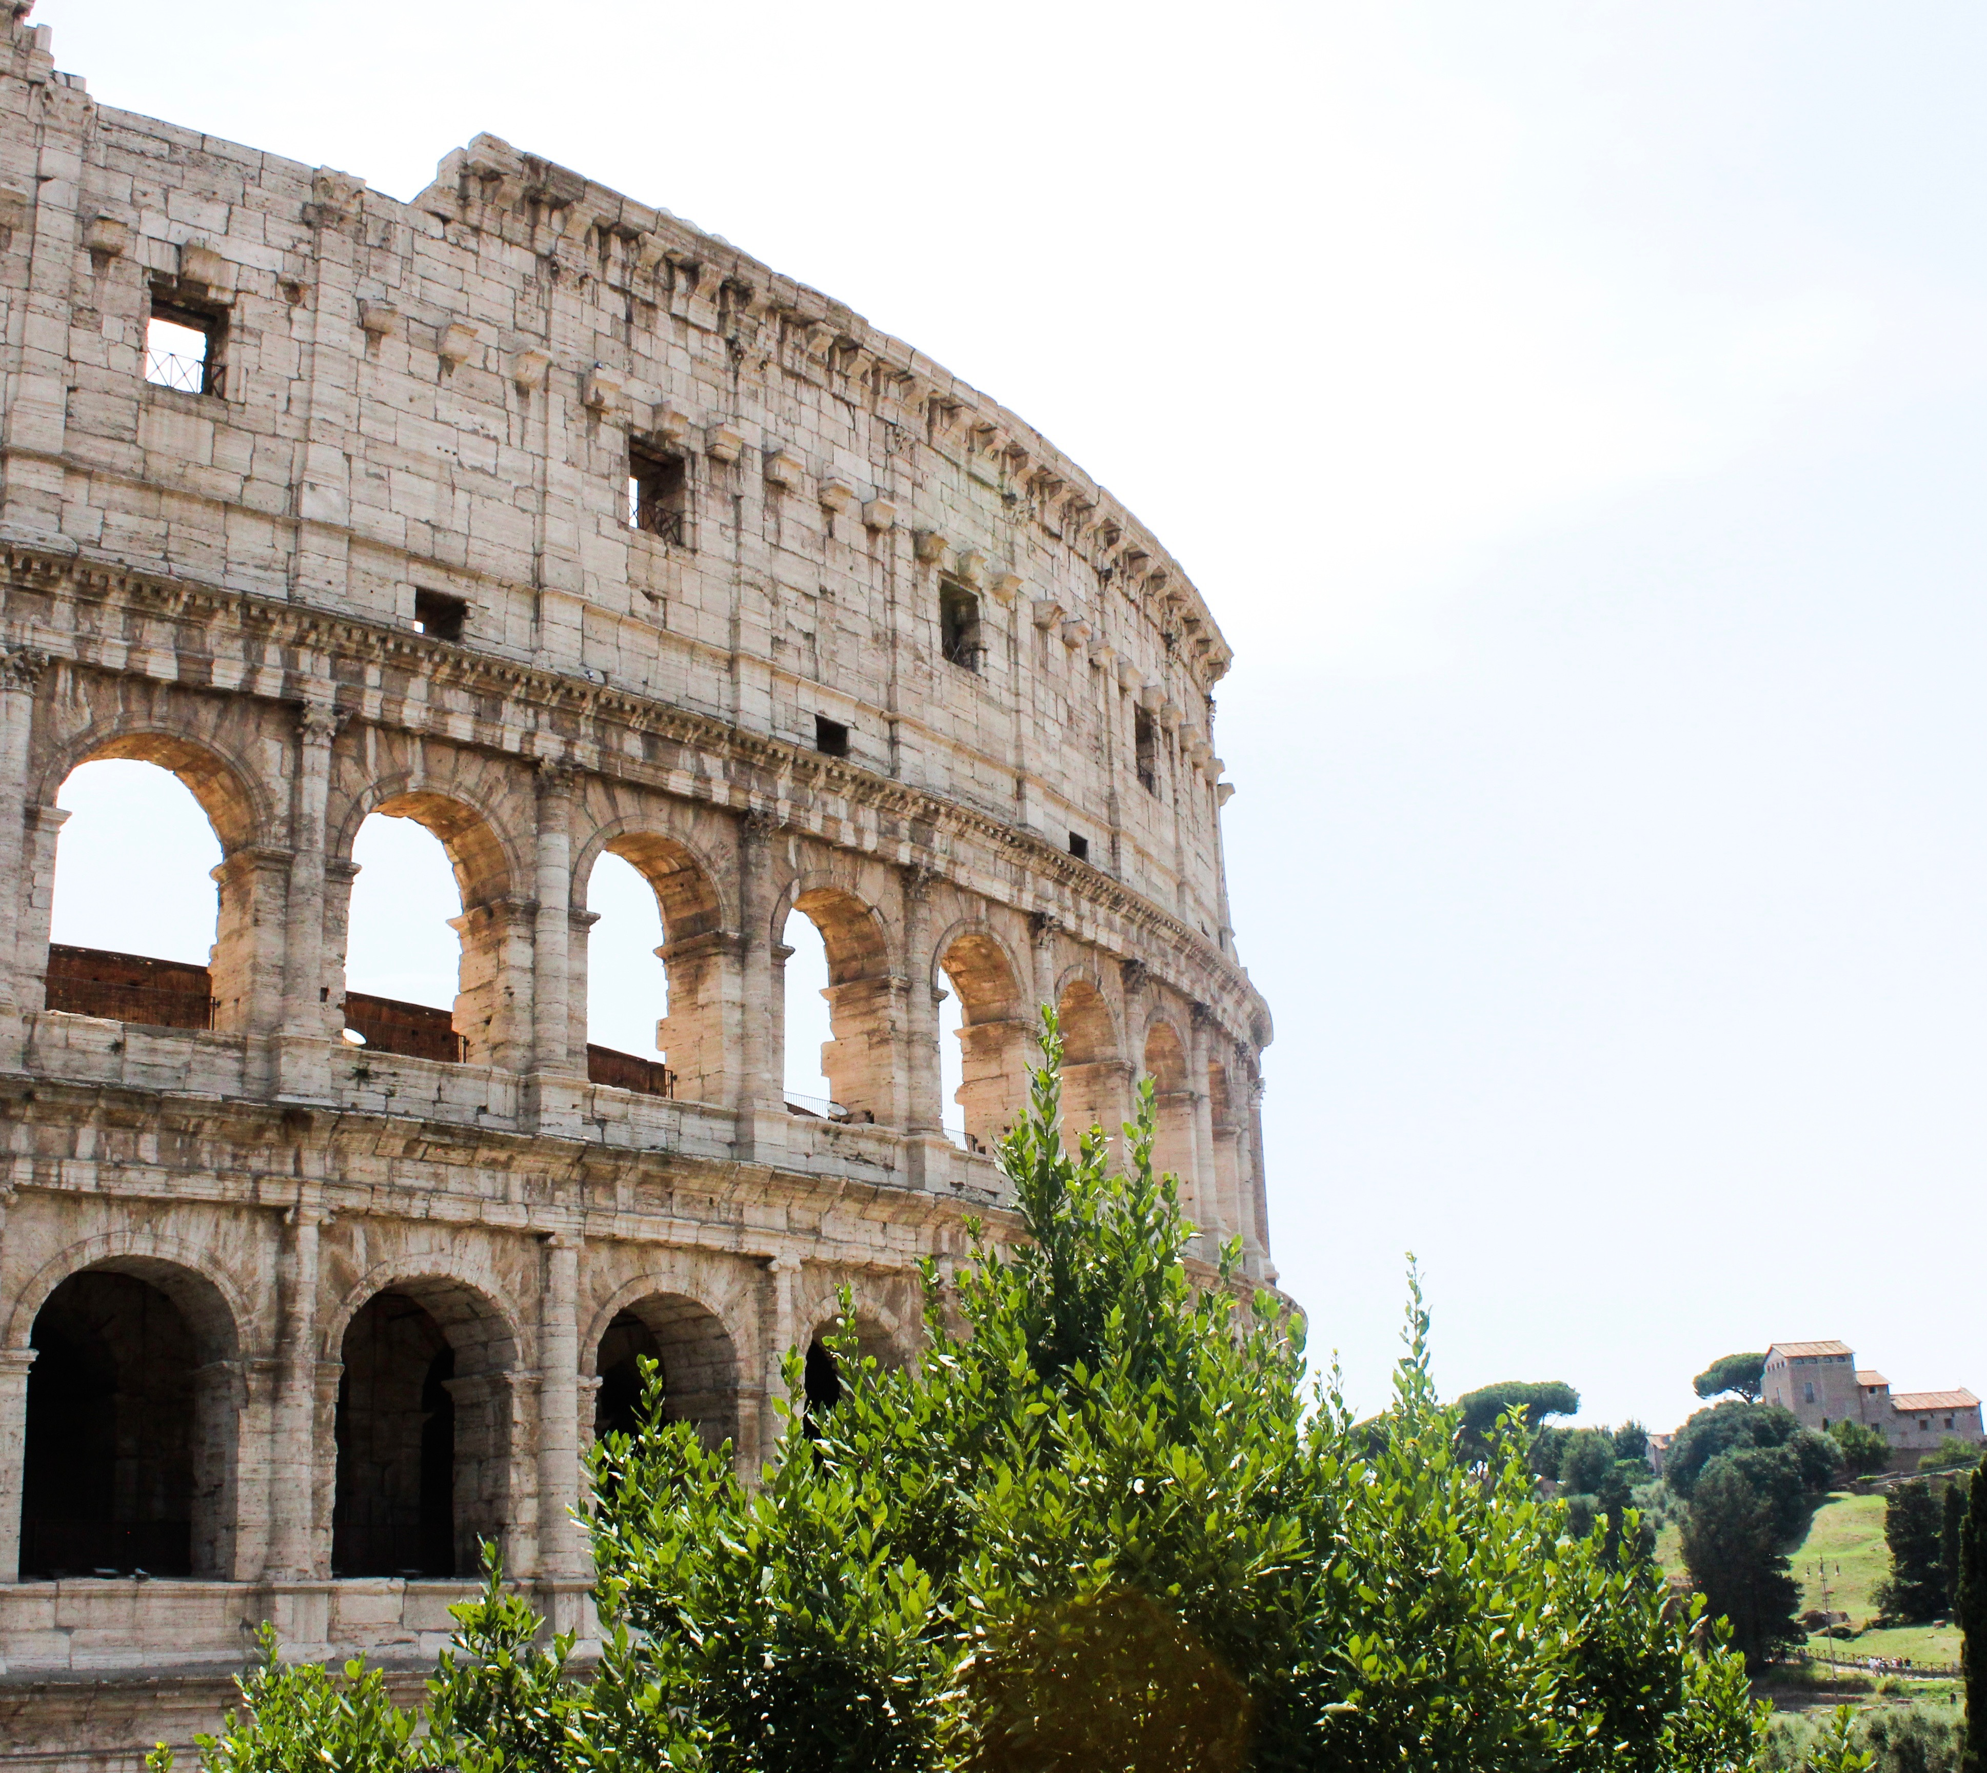
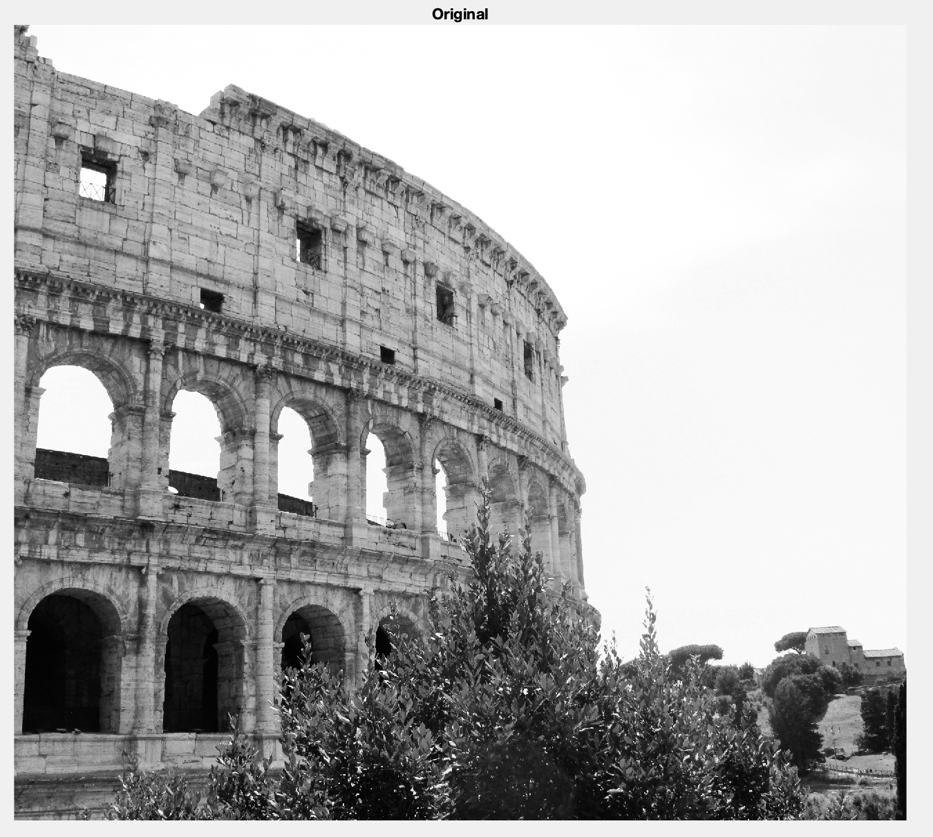
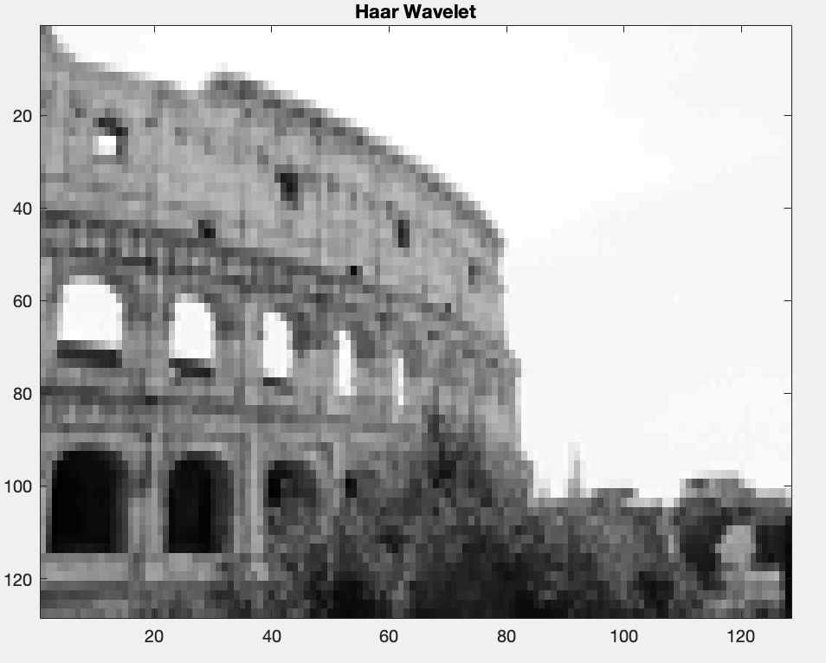
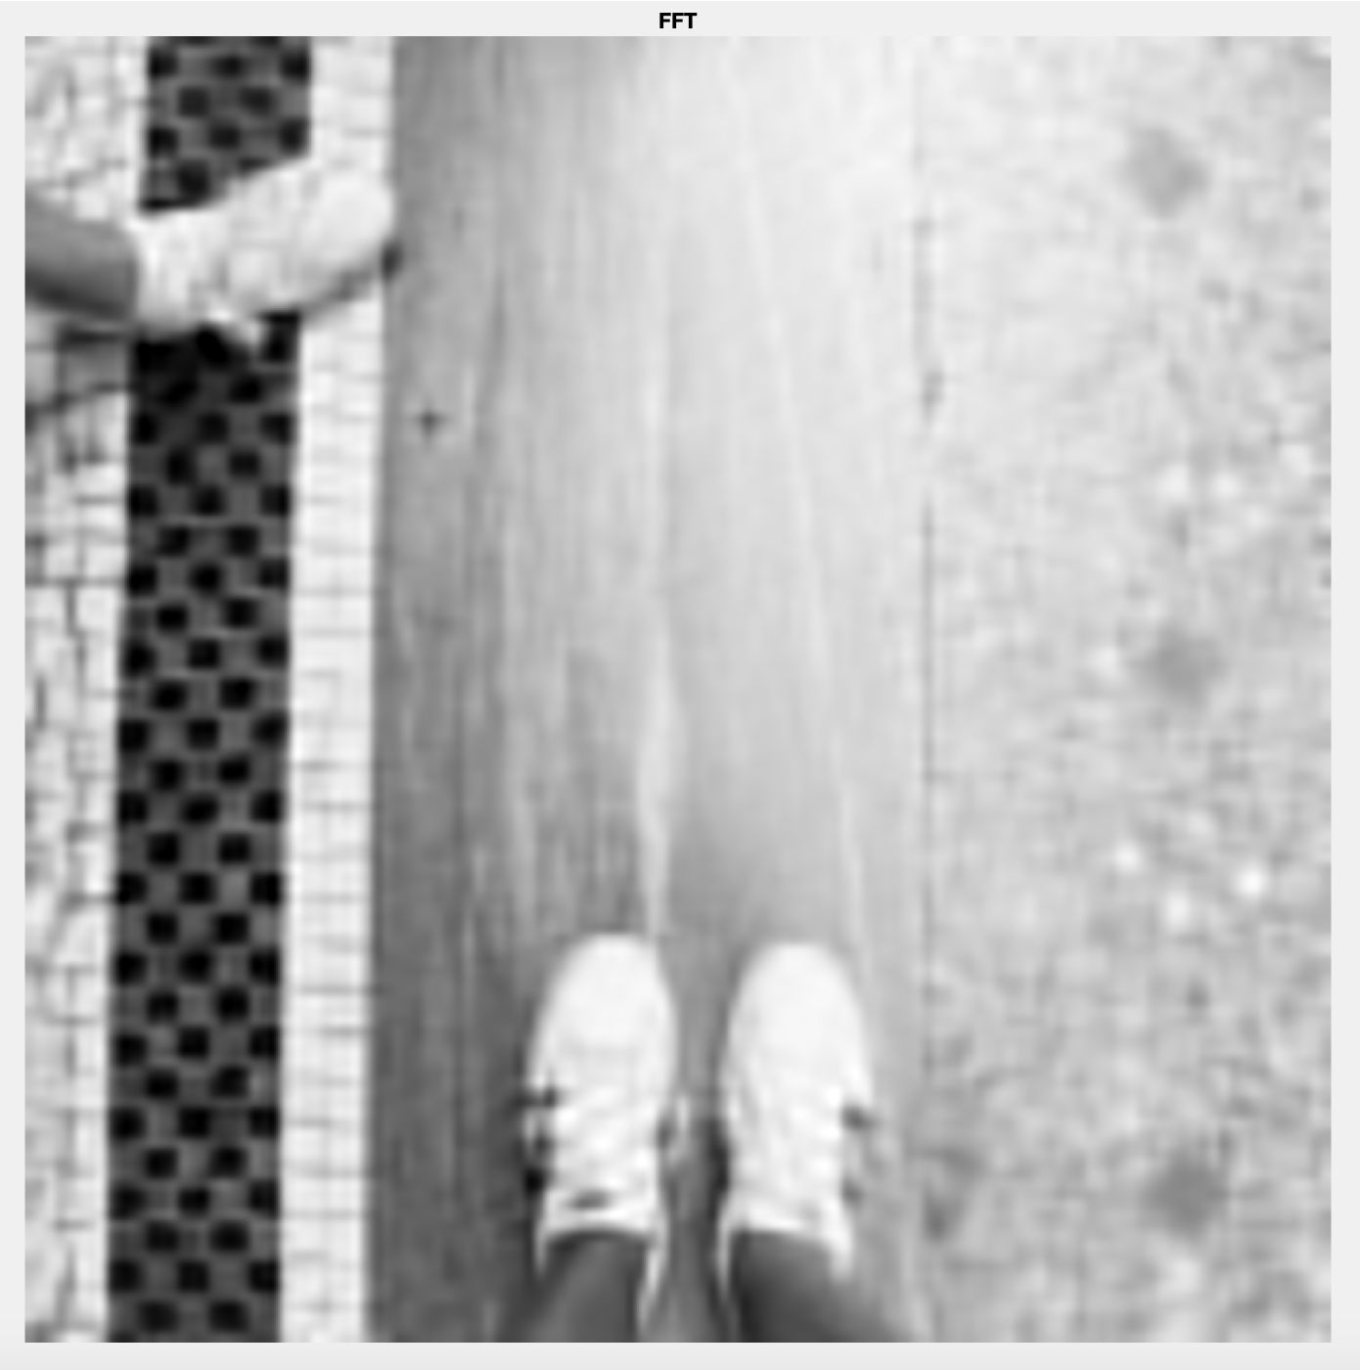

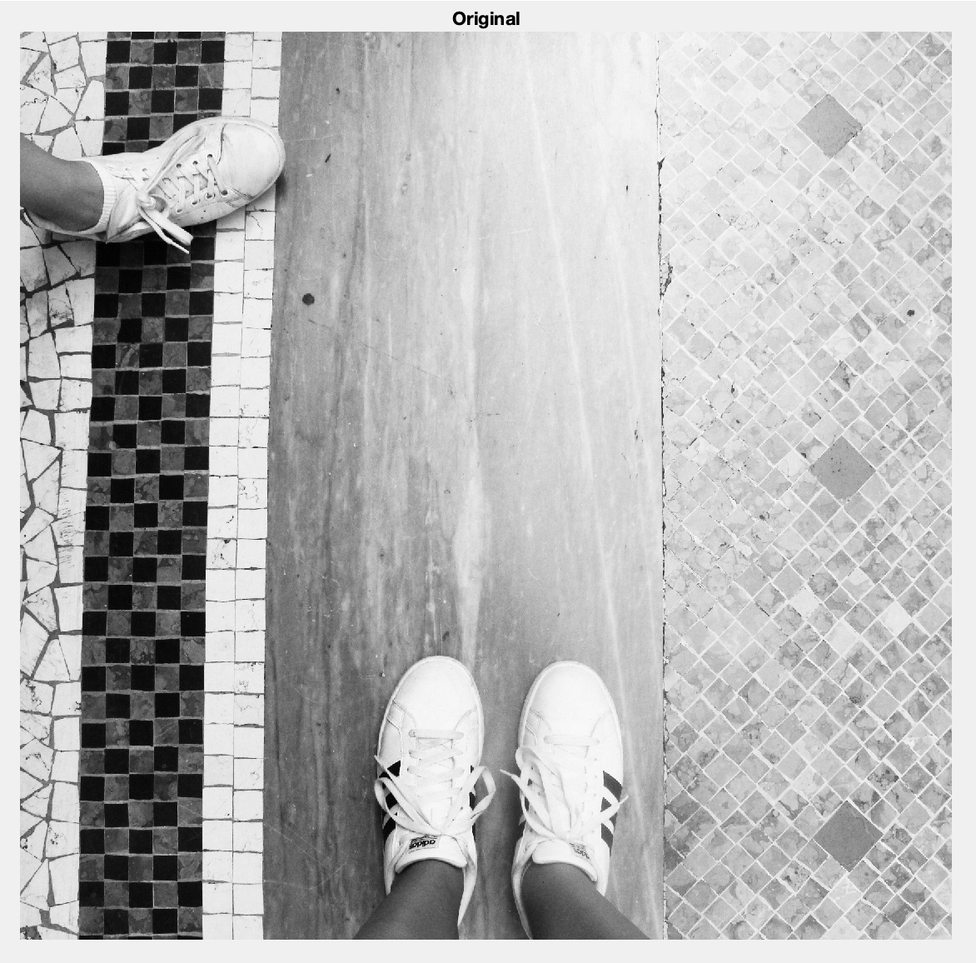
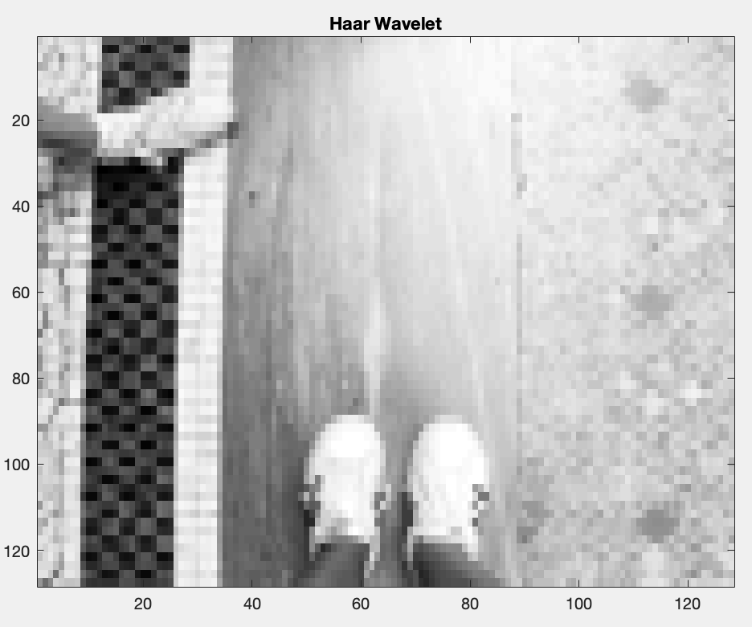
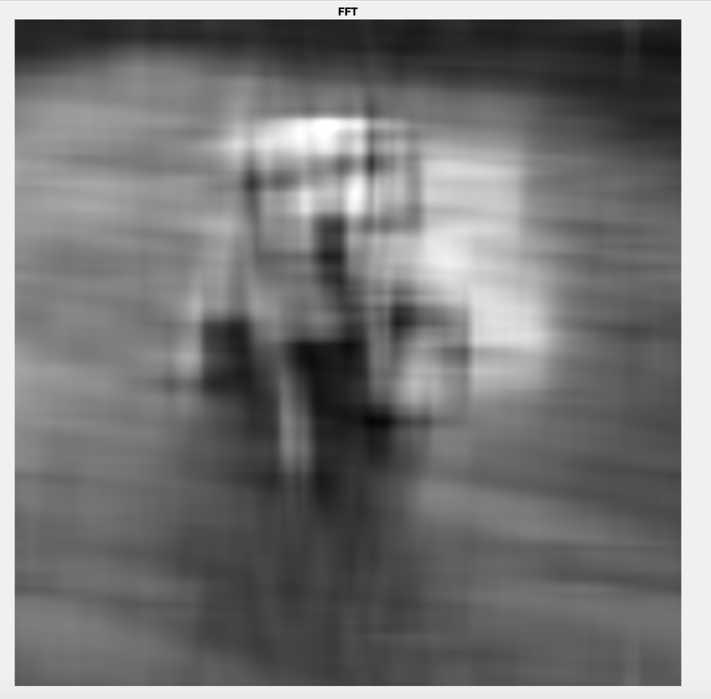
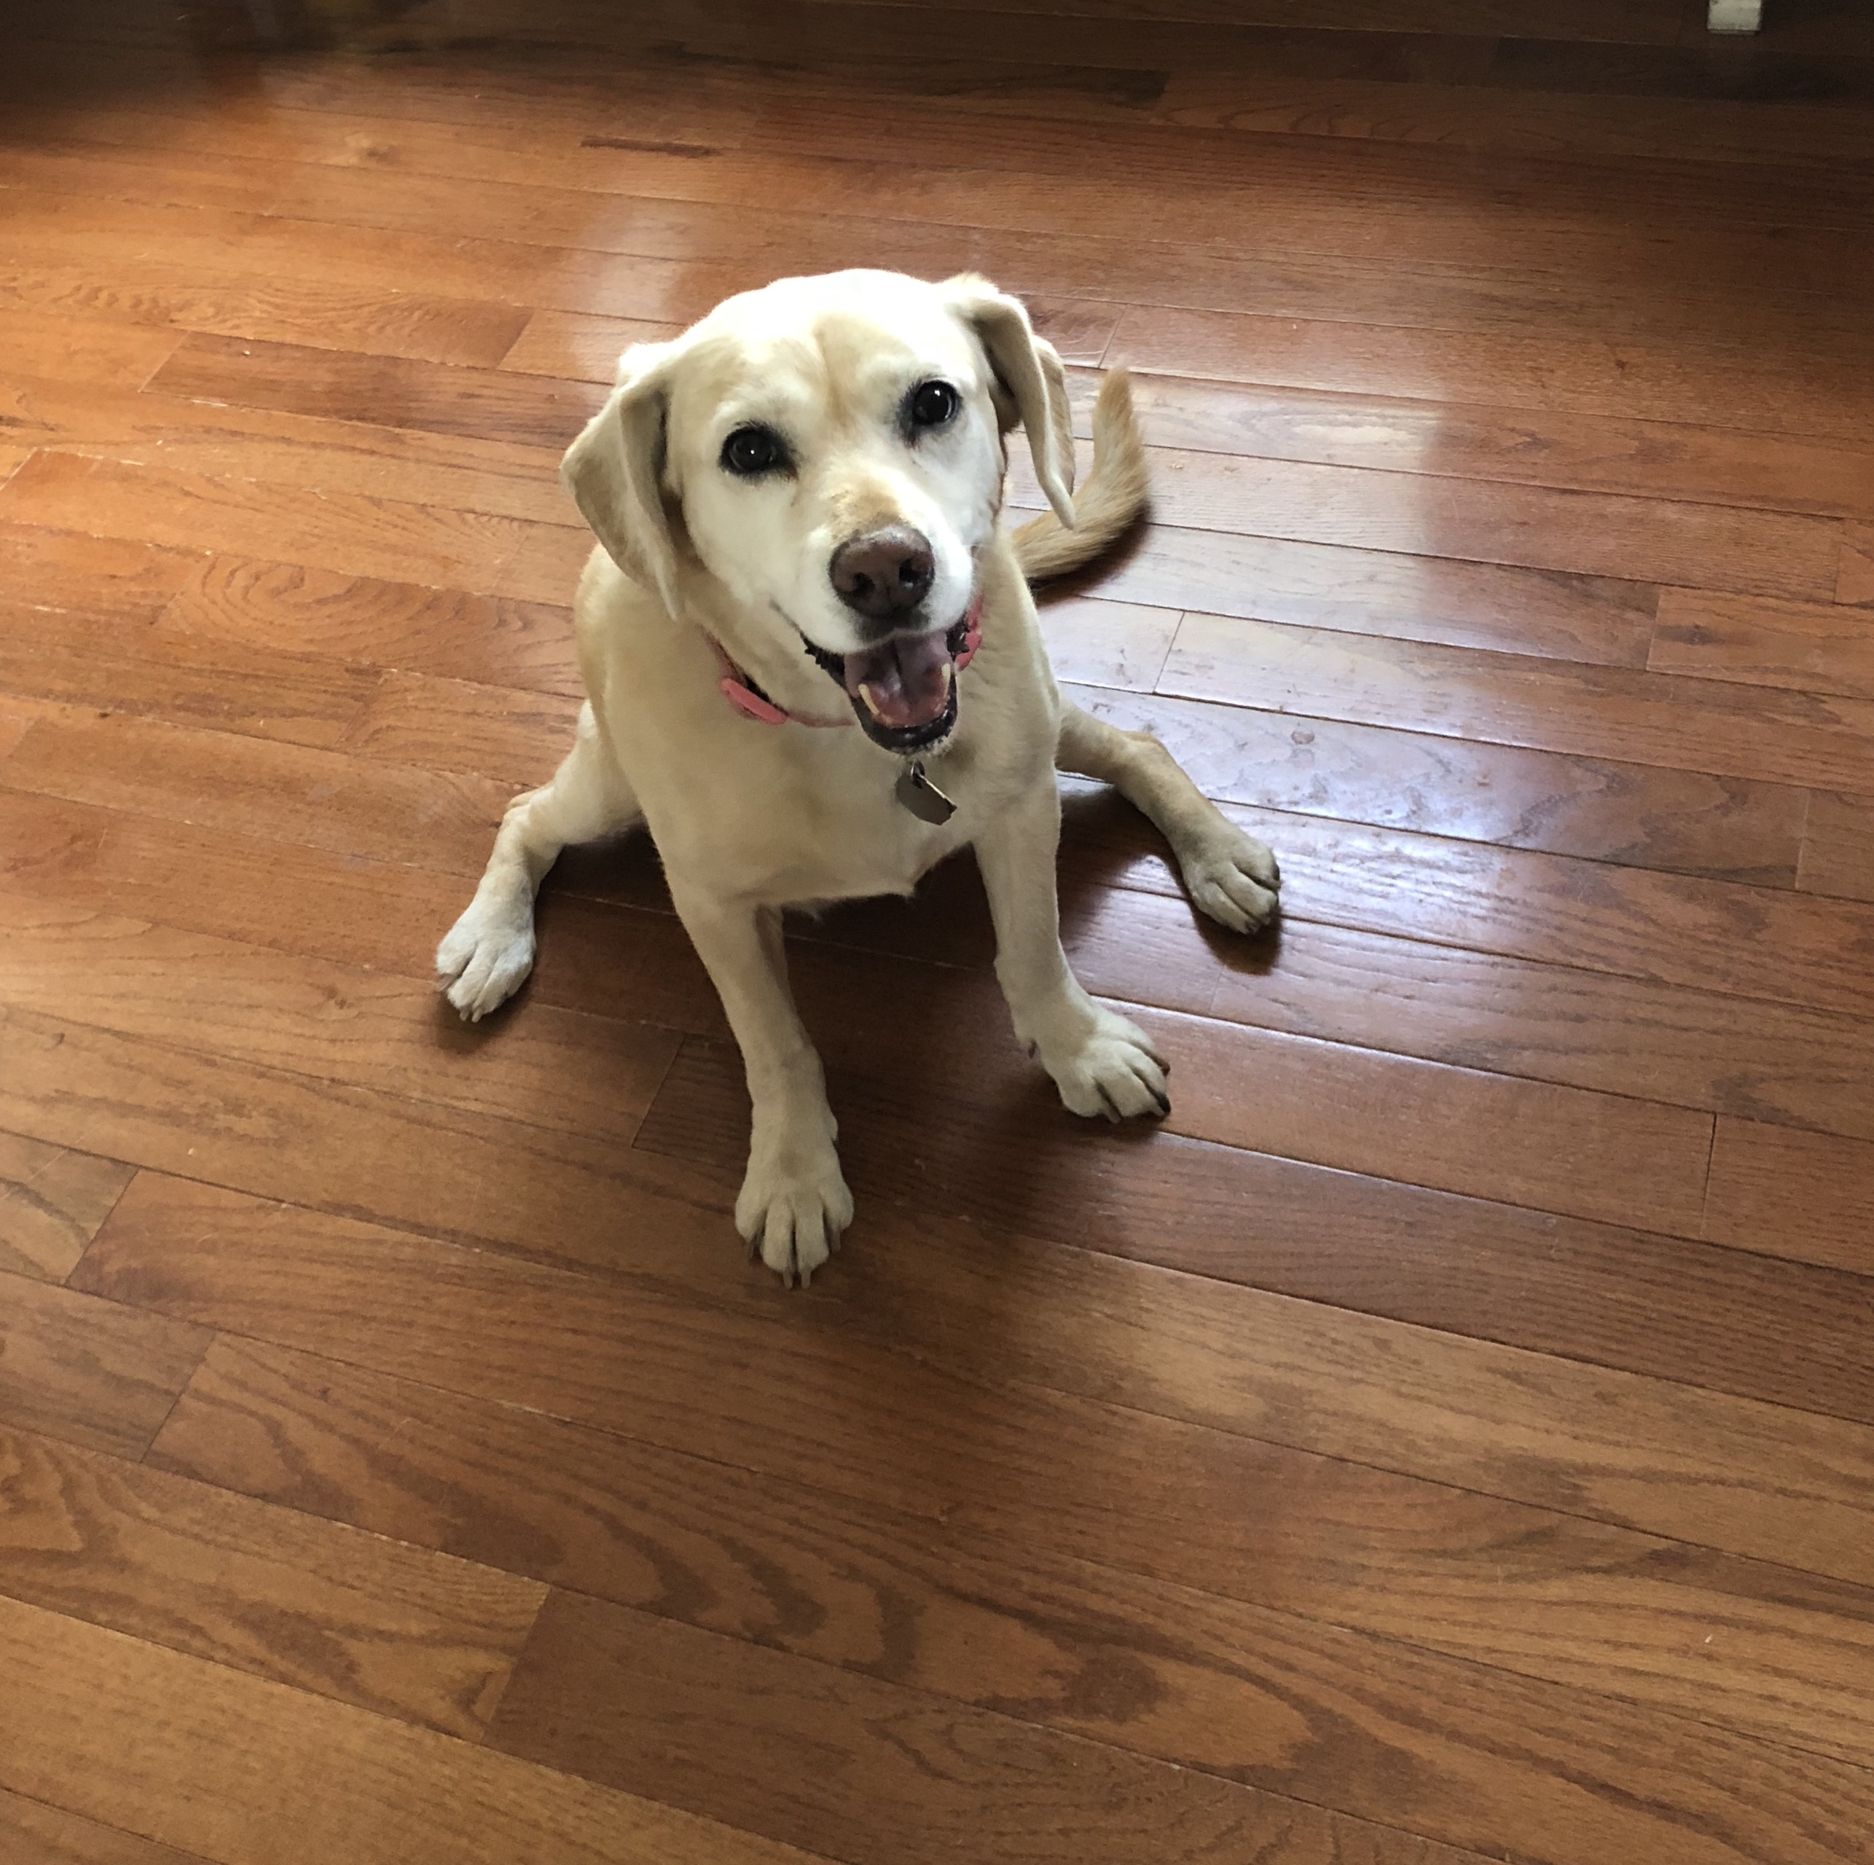
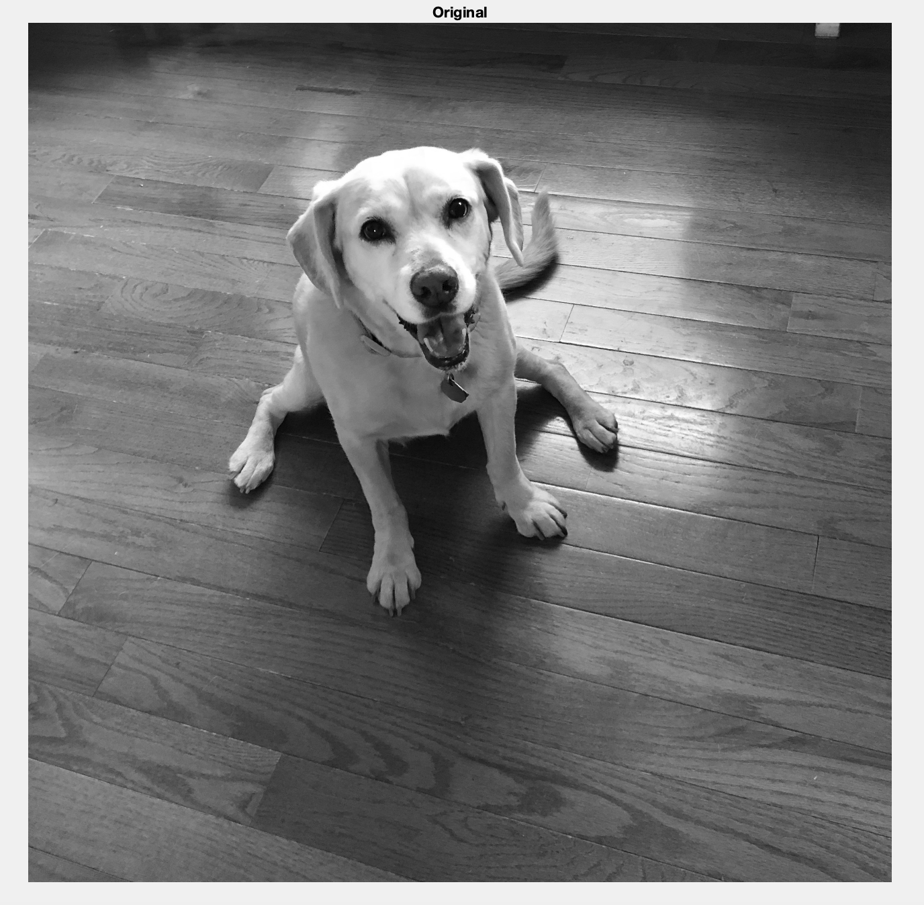
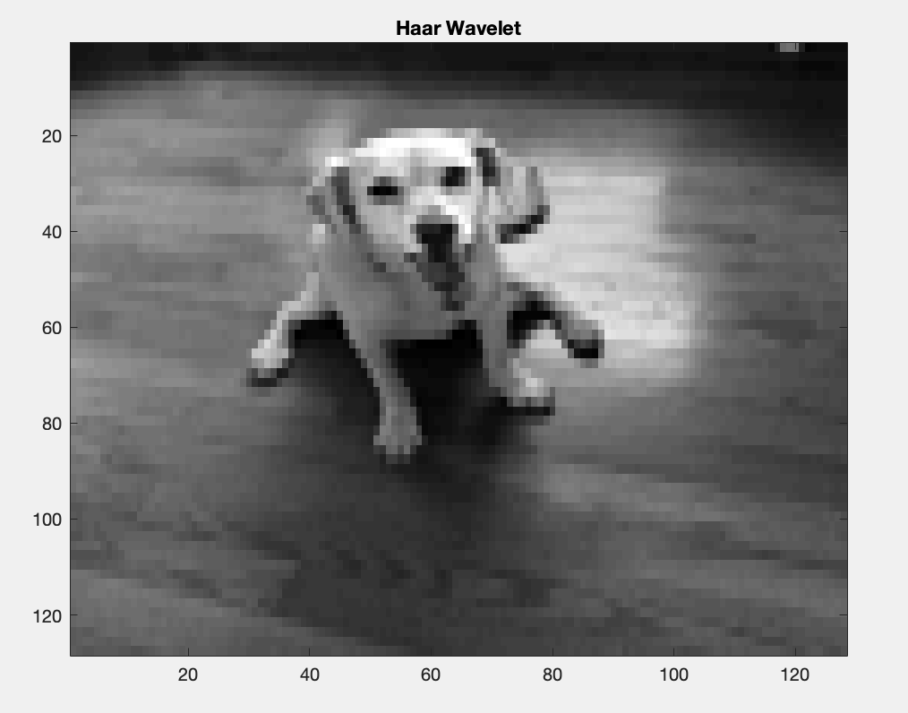
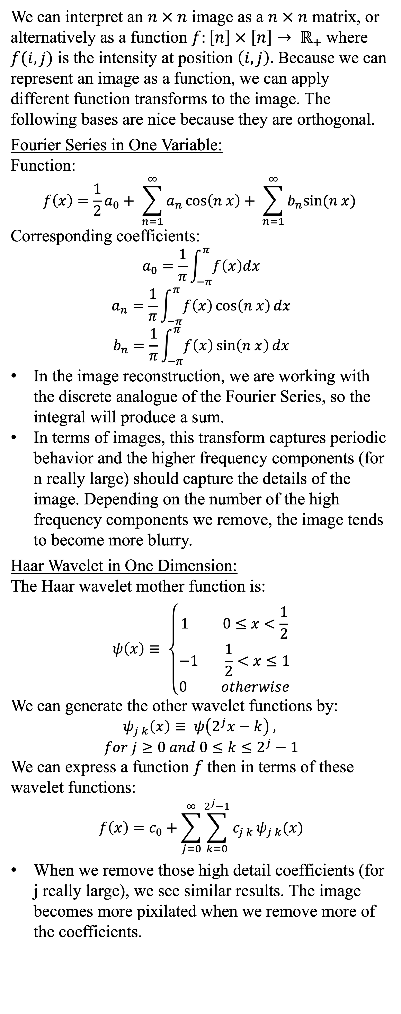
Image Reconstruction
Laura Nolt
MATH417 – Henry Kvinge
MATH450 – Manuchehr Aminian
We can interpret an $n × n$ image as a $n × n$ matrix, or alternatively as a function $f:\left[n\right] × \left[n\right]→ ℝ_{+}$where $f(i,j)$ is the intensity at position $\left(i,j\right).$ Because we can represent an image as a function, we can apply different function transforms to the image. The following bases are nice because they are orthogonal.
Fourier Series in One Variable:
Function:
$$f\left(x\right)=\frac{1}{2}a_{0}+ \sum_{n=1}^{∞}{a_{n}\cos\left(n x\right)+ \sum_{n=1}^{∞}{b_{n}sin⁡(n x)}}$$
Corresponding coefficients:
$$a_{0}=\frac{1}{π}\int_{−π}^{π}{f\left(x\right)dx}$$
$$a_{n}=\frac{1}{π}\int_{−π}^{π}{f\left(x\right)\cos\left(n x\right)dx}$$
$$b_{n}=\frac{1}{π}\int_{−π}^{π}{f\left(x\right)\sin\left(n x\right)dx}$$
In the image reconstruction, we are working with the discrete analogue of the Fourier Series, so the integral will produce a sum.
In terms of images, this transform captures periodic behavior and the higher frequency components (for n really large) should capture the details of the image. Depending on the number of the high frequency components we remove, the image tends to become more blurry.
Haar Wavelet in One Dimension:
The Haar wavelet mother function is:
$$ψ\left(x\right)≡ \left\{\begin{aligned}1 0≤x<\frac{1}{2} \\ −1 \frac{1}{2}<x≤1 \\ 0 otherwise\end{aligned}\right.$$
We can generate the other wavelet functions by:
$$ψ_{j k}\left(x\right)≡ ψ\left(2^{j}x−k\right) ,$$
$$for j≥0 and 0≤k≤2^{j}−1$$
We can express a function $f$then in terms of these wavelet functions:
$$f\left(x\right)=c_{0}+\sum_{j=0}^{∞}{\sum_{k=0}^{2^{j}−1}{c_{j k }ψ_{j k}(x)}}$$
When we remove those high detail coefficients (for j really large), we see similar results. The image becomes more pixilated when we remove more of the coefficients.
Fast Fourier Transform
(Removing high frequency coefficients)
Grey scale representation of the
original photograph.
Haar Wavelet Transform
(Removing detail coefficients)
Fast Fourier Transform
(Removing high frequency coefficients)
Grey scale representation of the
original photograph.
Haar Wavelet Transform
(Removing detail coefficients)
Fast Fourier Transform
(Removing high frequency coefficients)
Grey scale representation of the
original photograph.
Haar Wavelet Transform
(Removing detail coefficients)
Citations:
Wolfram Alpha LLC. 2009. Wolfram|Alpha. http://mathworld.wolfram.com/FourierSeries.html
Wolfram Alpha LLC. 2009. Wolfram|Alpha. http://mathworld.wolfram.com/HaarFunction.html

